Slide 1

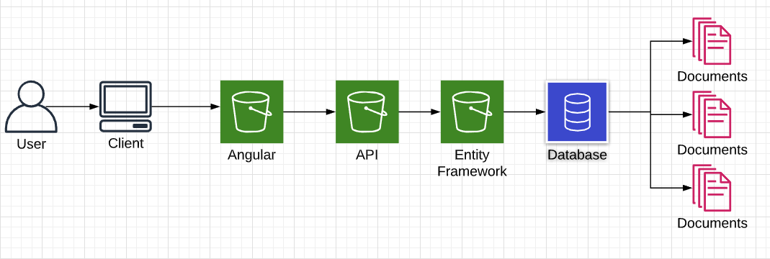









Electronic Health Records
Introduction
eHealth Records purpose is to systematically organize patient's health records, reduce errors in recording patient's data, reducing waiting time for health records while also transitioning the records online to the doctor's portal and removing paper recording.
Research
16 billion spent each year in Ireland on hospitals, equipment, office materials etc.
Over 500 million spent in UK trying to develop HER
GDRP halting projecting
Previous project scan in ID:
Have patients PPS
Allergies
Location
Functionality
Login/Register
Update User Data
Searching Filter
Watch List
Photo Upload
Messaging
User Roles
Results
9/10 practitioners surveyed opted for online implementation
All practitioners reported errors in records
Graphs incomplete
Details not filled in
Dates missing
Pages scattered and not organized
Waiting time for requested records can be between 3 days – 4 weeks
Goal
The patient/doctor will able to login or register on the webpage set up with ASP.NET Core which is hosted on NodeJS server with the user interface designed in Angular, HTML and CSS. The patient's data will be saved to the database (MySQL).
Software
Asp Dotnet Core
Angular
NodeJs
Azure
HTML5
CSS3
Cloudinary
MySQL
BEng (Hons) Software & Electronic Engineering
Adam Doyle

